Slide 1

Geometry
Unit 7, Lesson 5 Using Trigonometric Ratios Volume 1, pg. 393

Slide 2


Benchmark
MA.912.T.1.2
Solve mathematical and real-world problems involving right triangles using trigonometric ratios and the Pythagorean Theorem.
volume 1, pg. 393

Slide 3
Integrated Mathematical Thinking and Reasoning Standards
MA.K12.MTR.1.1 Actively participate in effortful learning both individually and collectively.
MA.K12.MTR.2.1 Demonstrate understanding by representing problems in multiple ways.
MA.K12.MTR.4.1 Engage in discussions that reflect on the mathematical thinking of self and others.
MA.K12.MTR.5.1 Use patterns and structure to help understand and connect mathematical concepts.
MA.K12.MTR.6.1 Assess the reasonableness of solutions.
volume 1, pg. 393

Slide 4

Learning Targets
I can use trigonometric ratios to find the side of a right triangle.
I can use trigonometric ratios to find an angle of a right triangle.
volume 1, pg. 393

Slide 5

Warm-Up
volume 1, pg. 394

Slide 6
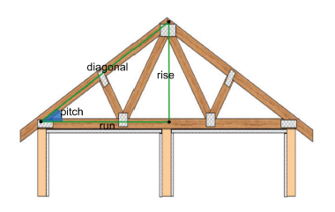
7.5.1 Warm-Up: Growth Mindset
In carpentry, right triangles are commonly used in constructing roofs. A roof’s pitch is the steepness of the roof. It can be determined by the ratio between the two legs of the right triangle.
What do you notice or wonder about the use of right triangles in construction?
volume 1, pg. 394

Slide 7

Collaboration
volume 1, pg. 394

Slide 8

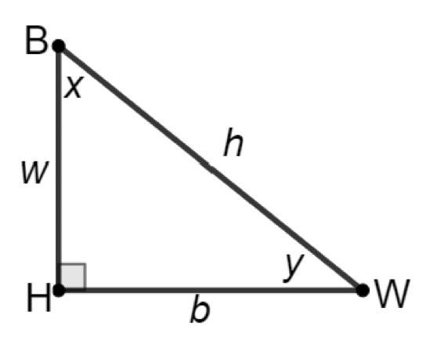

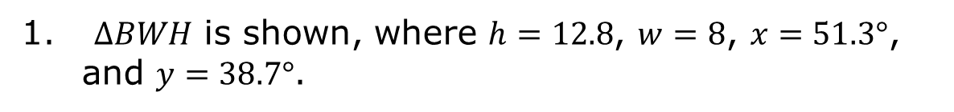
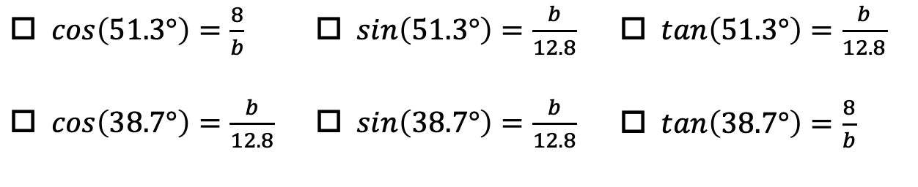
7.5.2 Collaboration: Using Trigonometric Ratios
$∆BWH$ is shown, where $h=12.8$, $w=8$, $x=51.3°$, and $y=38.7°$.
Select all of the equations that can be used to find the value of $b$.
$\cos\left(51.3°\right)=\frac{8}{b}$ | $\sin\left(51.3°\right)=\frac{b}{12.8}$ | $\tan\left(51.3°\right)=\frac{b}{12.8}$
$\cos\left(38.7°\right)=\frac{b}{12.8}$ | $\sin\left(38.7°\right)=\frac{b}{12.8}$ | $\tan\left(38.7°\right)=\frac{8}{b}$
Determine the value of $b$. Round to the nearest thousandth.
volume 1, pg. 394

Slide 9
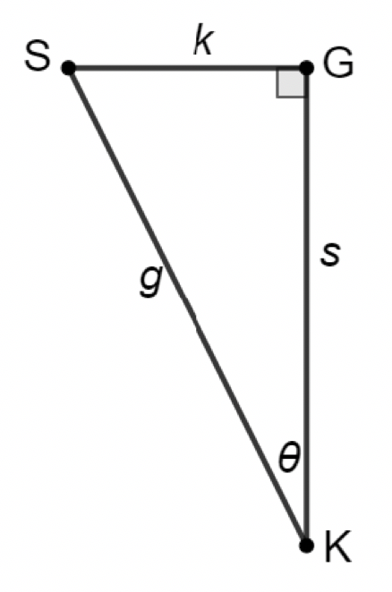
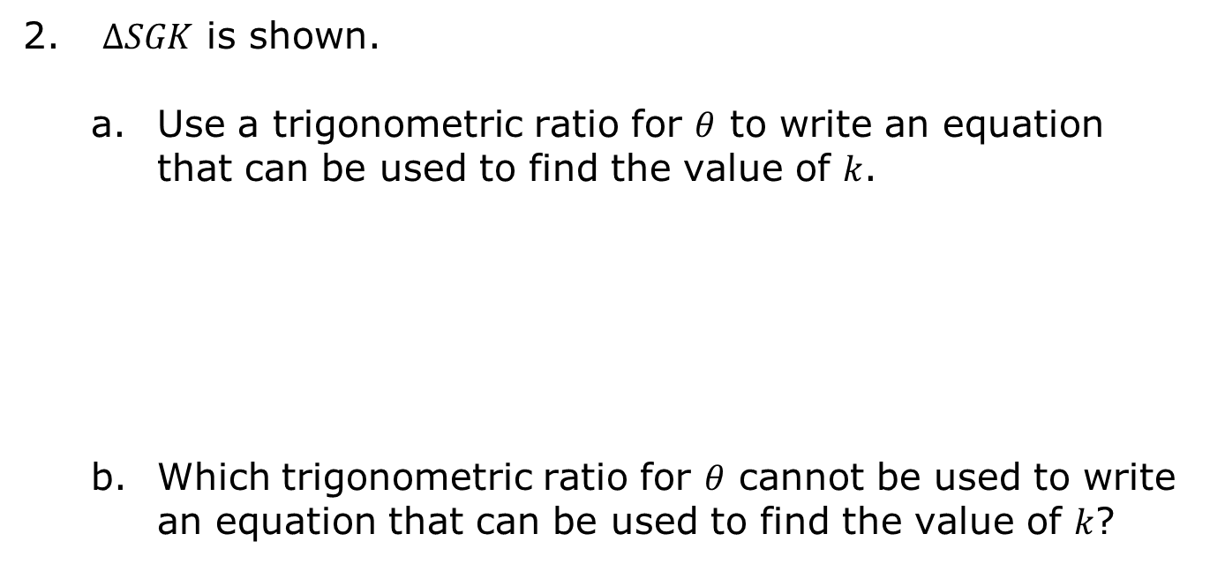
$∆SGK$ is shown.
Use a trigonometric ratio for $θ$ to write an equation that can be used to find the value of $k$.
Which trigonometric ratio for $θ$ cannot be used to write an equation that can be used to find the value of $k$?
volume 1, pg. 395

Slide 10
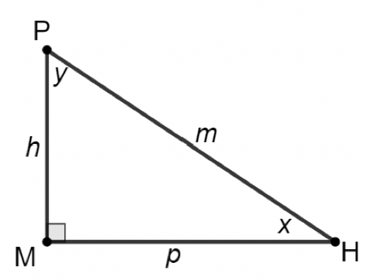
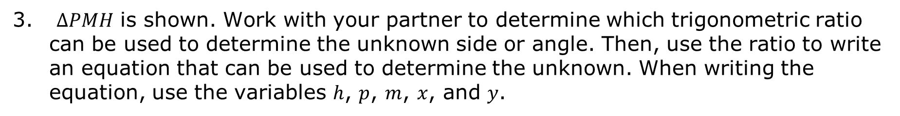
$∆PMH$ is shown. Work with your partner to determine which trigonometric ratio can be used to determine the unknown side or angle. Then, use the ratio to write an equation that can be used to determine the unknown. When writing the equation, use the variables $h$, $p$, $m$, $x$, and $y$.
volume 1, pg. 395

Slide 11
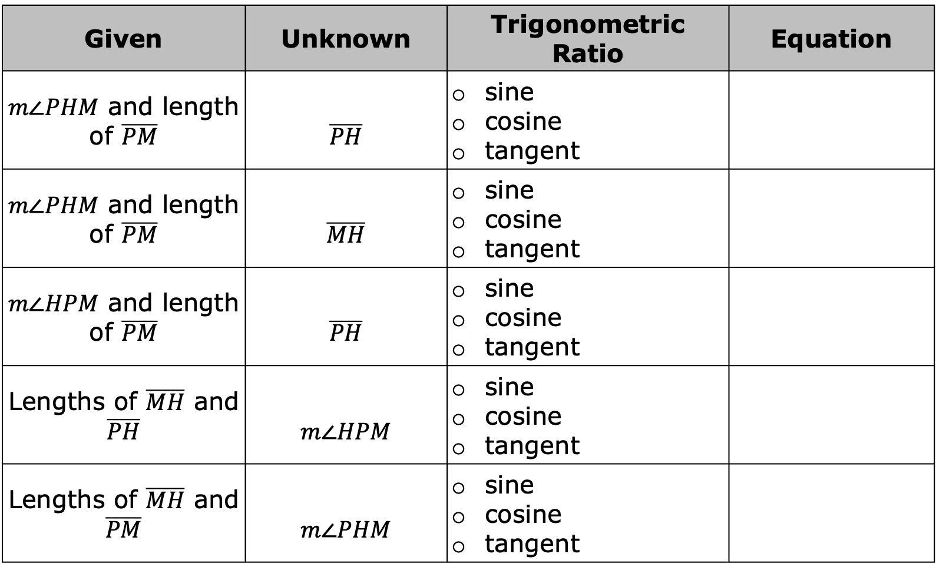
Given | Unknown | Trigonometric Ratio | Equation
$m∠PHM$ and length of $\overline{PM}$ | $$\overline{PH}$$ | sine cosine tangent
$m∠PHM$ and length of $\overline{PM}$ | $$\overline{MH}$$ | sine cosine tangent
$m∠HPM$ and length of $\overline{PM}$ | $$\overline{PH}$$ | sine cosine tangent
Lengths of $\overline{MH}$ and $\overline{PH}$ | $$m∠HPM$$ | sine cosine tangent
Lengths of $\overline{MH}$ and $\overline{PM}$ | $$m∠PHM$$ | sine cosine tangent
volume 1, pg. 395

Slide 12

Guided Instruction
volume 1, pg. 396

Slide 13

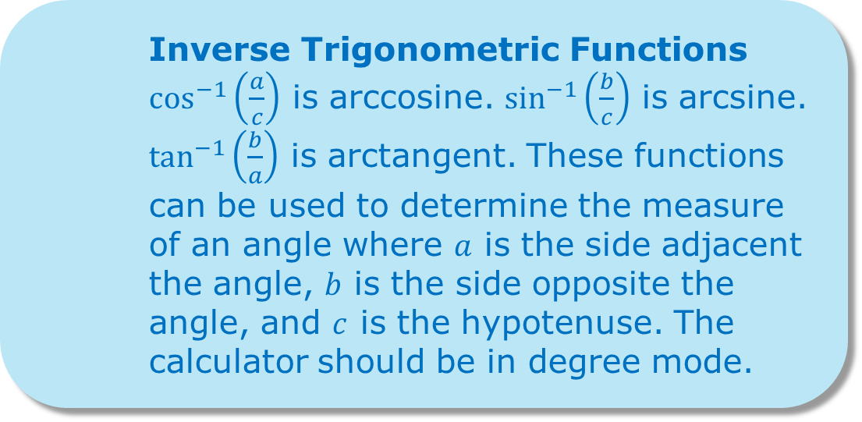
7.5.3 Guided Instruction: Using Inverse Trigonometric Functions to Find Angle Measure
Inverse Trigonometric Functions
$\cos^{−1}\left(\frac{a}{c}\right)$ is arccosine. $\sin^{−1}\left(\frac{b}{c}\right)$ is arcsine. $\tan^{−1}\left(\frac{b}{a}\right)$ is arctangent. These functions can be used to determine the measure of an angle where $a$ is the side adjacent the angle, $b$ is the side opposite the angle, and $c$ is the hypotenuse. The calculator should be in degree mode.
volume 1, pg. 396

Slide 14
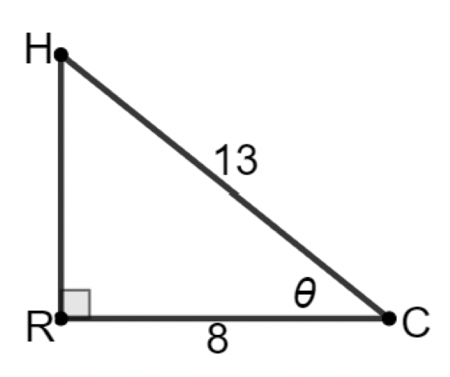
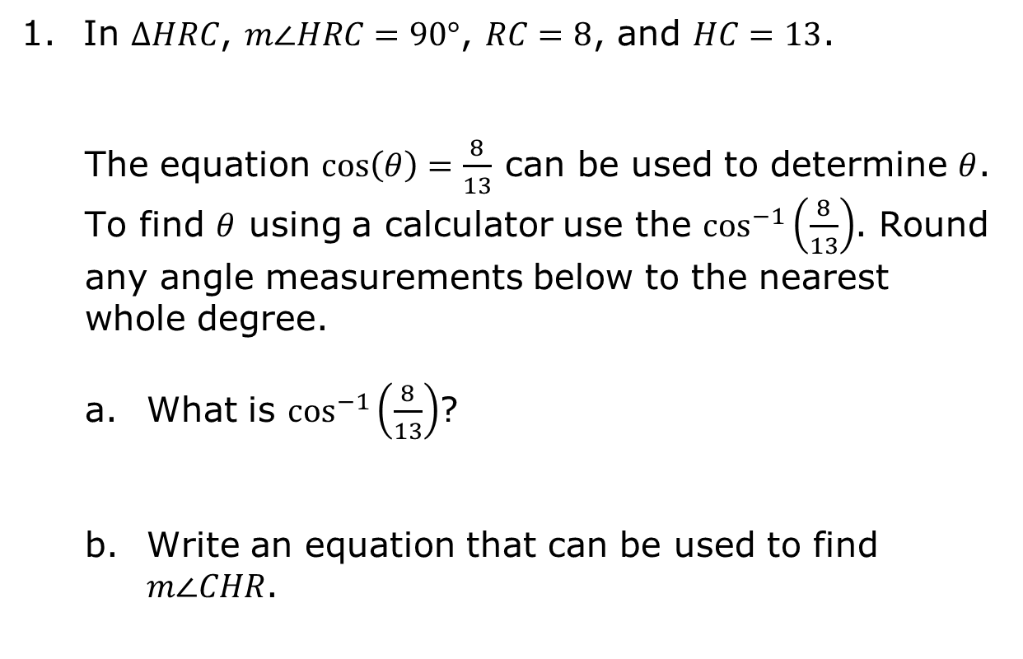
In $ΔHRC$, $m∠HRC=90°$, $RC=8$, and $HC=13$.
The equation $cos\left(θ\right)=\frac{8}{13}$ can be used to determine $θ$. To find $θ$ using a calculator use the $\cos^{−1}\left(\frac{8}{13}\right)$. Round any angle measurements below to the nearest whole degree.
What is $\cos^{−1}\left(\frac{8}{13}\right)$?
Write an equation that can be used to find $m∠CHR$.
volume 1, pg. 396

Slide 15
Find $m∠CHR$ using an inverse trigonometric function on a calculator. Be sure the calculator is in degree mode.
volume 1, pg. 396

Slide 16
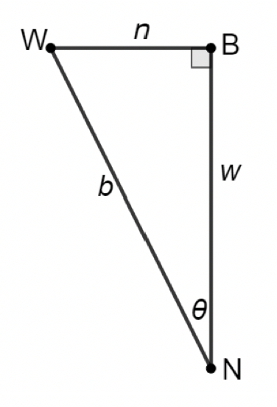
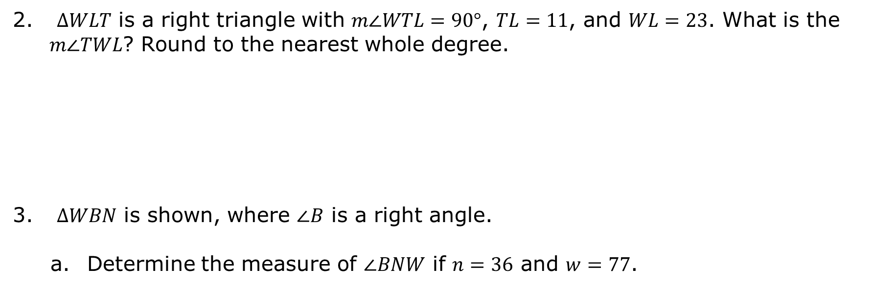
$ΔWLT$ is a right triangle with $m∠WTL=90°$, $TL=11$, and $WL=23$. What is the $m∠TWL$? Round to the nearest whole degree.
$∆WBN$ is shown, where $∠B$ is a right angle.
Determine the measure of $∠BNW$ if $n=36$ and $w=77$.
volume 1, pg. 396

Slide 17
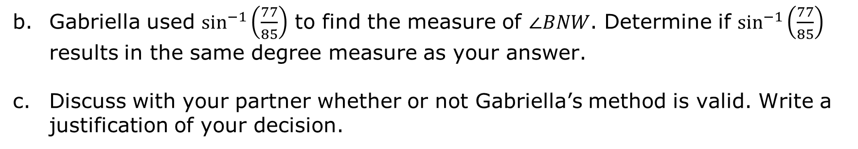
Gabriella used $\sin^{−1}\left(\frac{77}{85}\right)$ to find the measure of $∠BNW$. Determine if $\sin^{−1}\left(\frac{77}{85}\right)$ results in the same degree measure as your answer.
Discuss with your partner whether or not Gabriella’s method is valid. Write a justification of your decision.
volume 1, pg. 397

Slide 18

Guided Practice
volume 1, pg. 397

Slide 19

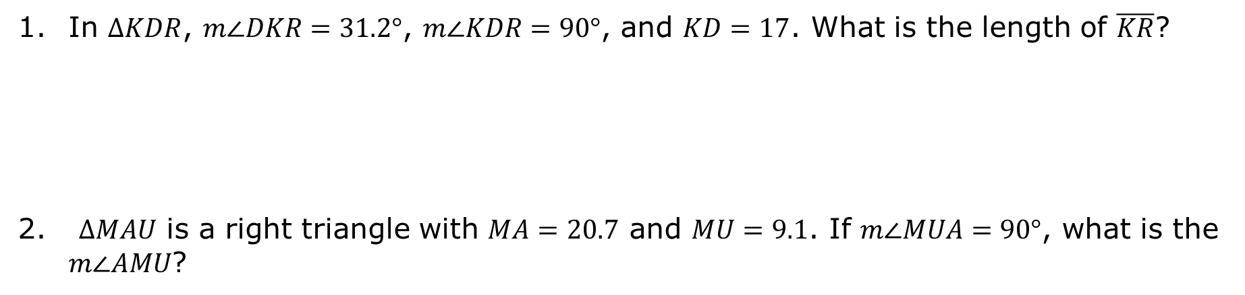
7.5.4 Guided Practice: Using Trigonometric Ratios to Find Side Measures
In $ΔKDR$, $m∠DKR=31.2°$, $m∠KDR=90°$, and $KD=17$. What is the length of $\overline{KR}$?
$ΔMAU$ is a right triangle with $MA=20.7$ and $MU=9.1$. If $m∠MUA=90°$, what is the $m∠AMU$?
volume 1, pg. 397

Slide 20
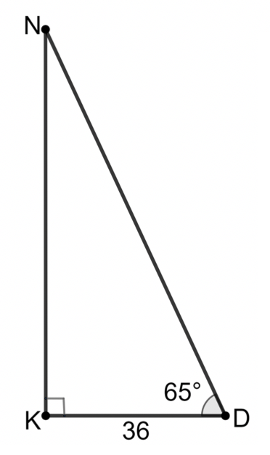
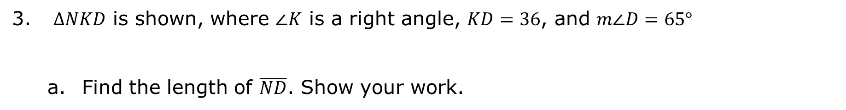
$∆NKD$ is shown, where $∠K$ is a right angle, $KD=36$, and $m∠D=65°$
Find the length of $\overline{ND}$. Show your work.
volume 1, pg. 397

Slide 21
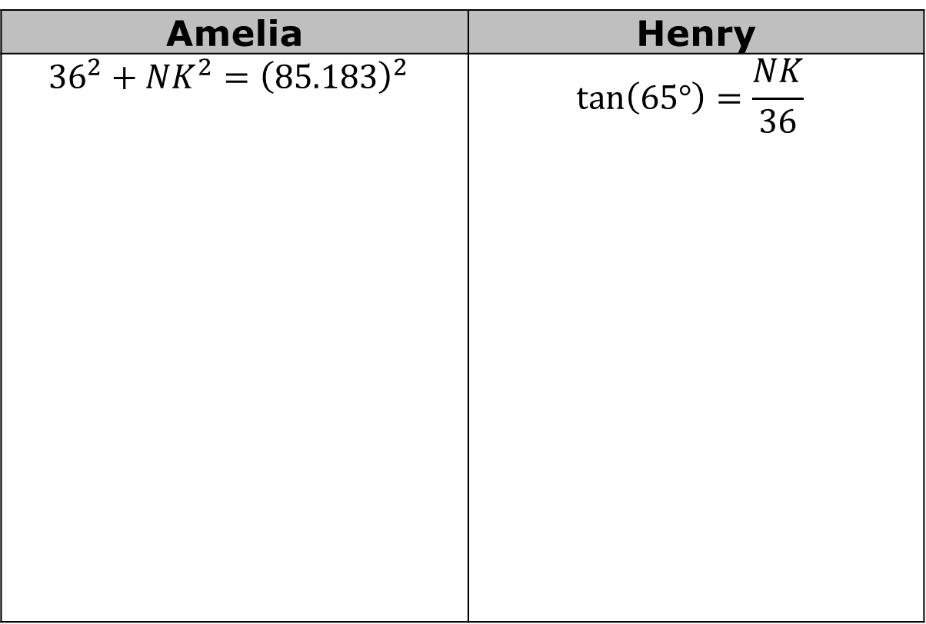
Amelia and Henry found the length of $\overline{NK}$ using two different methods. The first step of their work is shown. Complete their work.
Amelia | Henry
$${36}^{2}+{NK}^{2}={\left(85.183\right)}^{2}$$ | $$tan\left(65°\right)=\frac{NK}{36}$$
volume 1, pg. 398

Slide 22
Describe some possible reasons that Amelia’s and Henry’s answers are not exactly the same value.
Whose method gives a precise answer?
volume 1, pg. 398

Slide 23
Guided Practice
volume 1, pg. 398

Slide 24


7.5.5 Guided Practice: Using Trigonometric Ratios
$∆ZME$ has $ME=14.9$ and $m∠ZEM=41.5°$.
If $∠ZME$ is a right angle, what is the length of $\overline{ZM}$?
Sharif used the information to determine the length of $\overline{ZM}$.
Her work is shown below.
Find Sharif’s error and correct it.
$$\tan{41.5°}=\frac{14.9}{ZM}$$
$$ZM∙\tan{41.5°}=14.9$$
$$ZM=\frac{14.9}{\tan{41.5°}}$$
$$ZM≈16.841$$
volume 1, pg. 398

Slide 25
$ΔKNP$ is a right triangle with $KP=46$ and $KN=27.3$. If $∠PNK$ is a right angle, what is the $m∠KPN$?
volume 1, pg. 399

Slide 26

Wrap-Up
volume 1, pg. 399

Slide 27
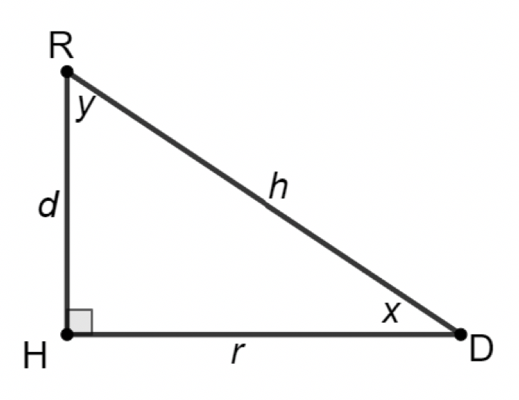
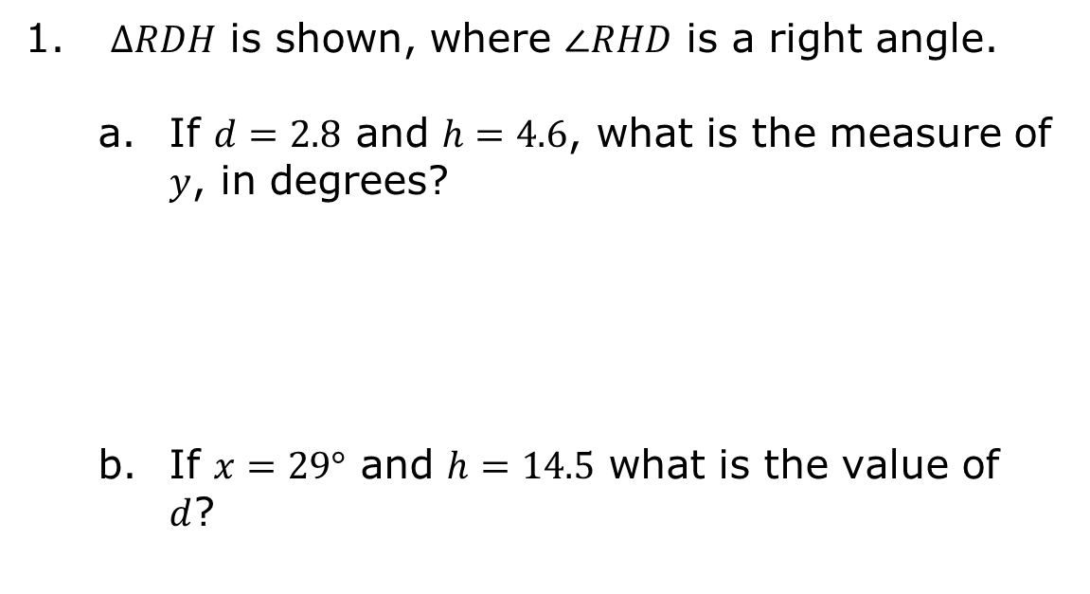
7.5.6 Wrap-Up: Ticket Out the Door
$∆RDH$ is shown, where $∠RHD$ is a right angle.
If $d=2.8$ and $h=4.6$, what is the measure of $y$, in degrees?
If $x=29°$ and $h=14.5$ what is the value of $d$?
volume 1, pg. 399

